Slide 1
ACUTE KIDNEY INJURY IN CHILDREN
DR BASHIR ADMANI
PEDIATRIC NEPHROLOGY

Slide 2
DEFINITION
Acute loss of kidney function
Retention of urea, creatinine
Inability to maintain fluid and electrolyte balance

Slide 3
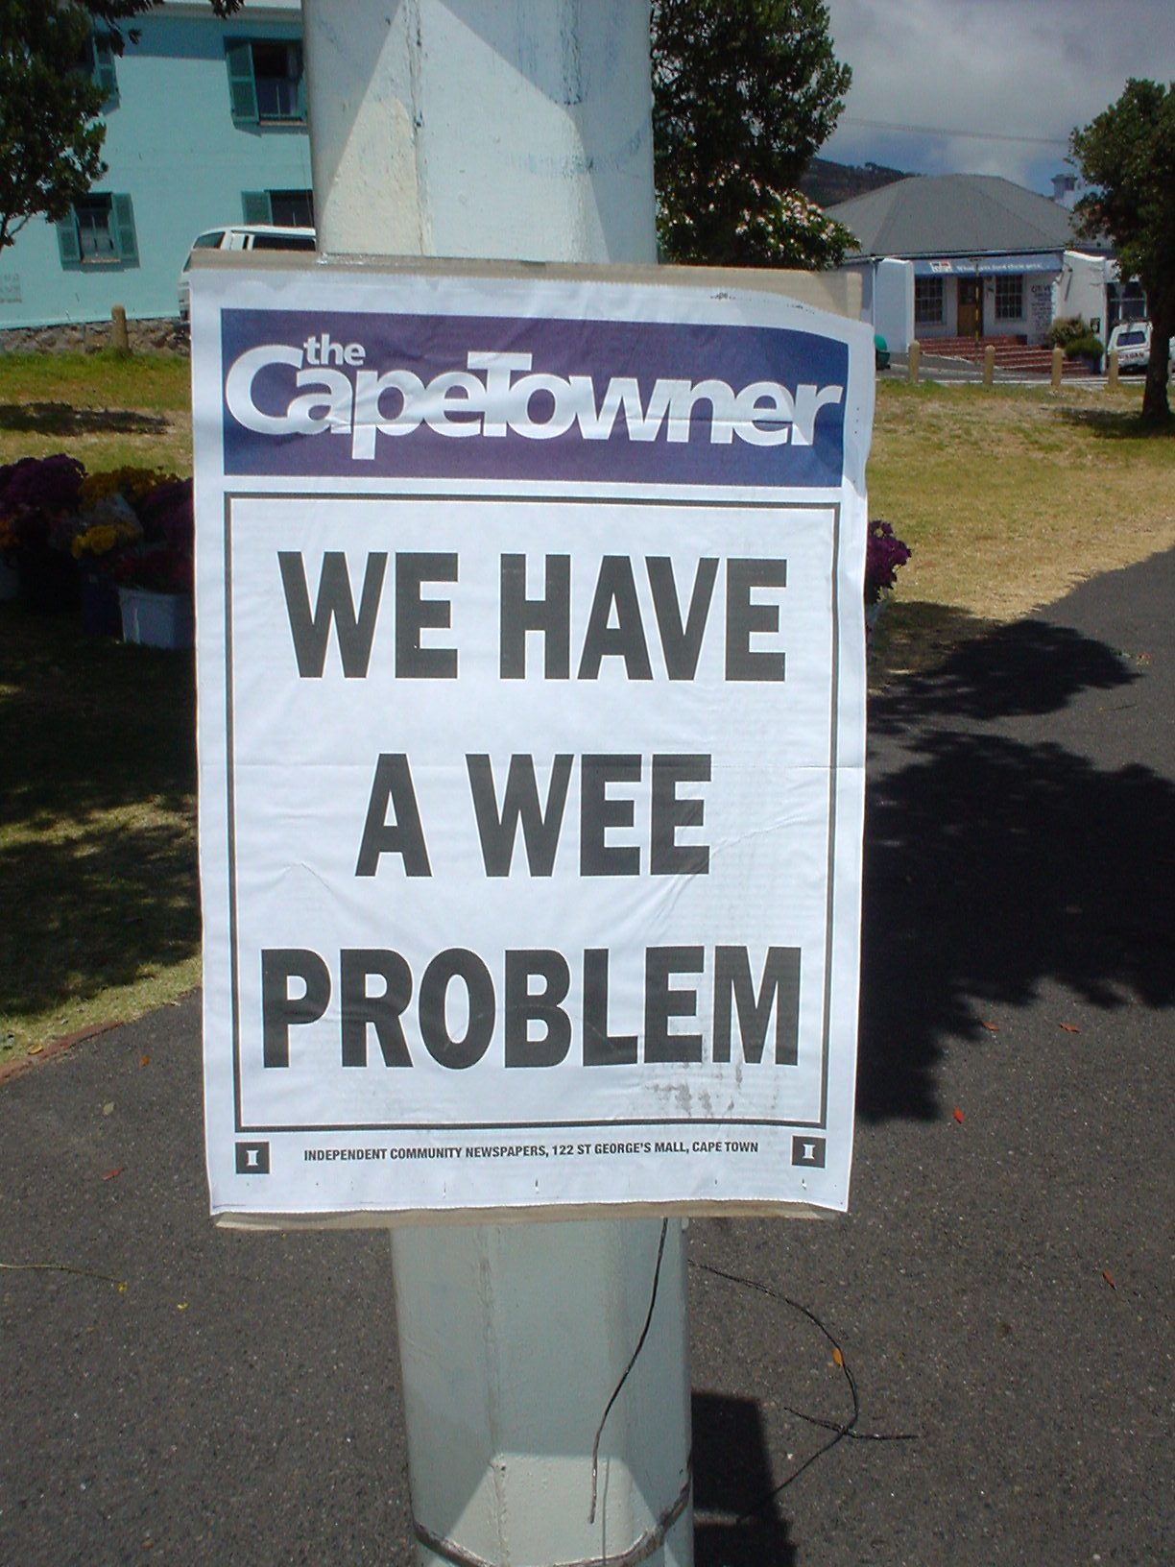

Slide 4
WHY AKI????
Present in 1 to 5% of inpatients
Present in up to 20% of ICU patients
KNH upto 85% critically ill children have AKI
60-70% maybe prerenal and avoidable

Slide 5
Classification of causes
Prerenal
Intrinsic renal
Post renal

Slide 6
PRERENAL CAUSES
Hypovolaemia
Peripheral vasodilation
Impaired cardiac output
Bilateral renal vessel occlusion
Drugs
Others

Slide 7
Intrinsic renal failure
Disease of kidney, AGN, ATN, HUS,
Myoglobinuria
Intratubular obstruction
Iatrogenic
Tumour infiltrate
drugs

Slide 8
POSTRENAL
PUV
Blocked catheter
Neurogenic bladder
Calculi
Tumours
Trauma

Slide 9
CASE
T I
3 ½ month old
Presenting complaint: cough, fast breathing, fever
On exam: tachypnoeic, crepitations, reduced air entry right side
Day 3 deteriorating renal function with anuria

Slide 10
INVESTIGATION
FBC:
Hb 6.7g/dl, Platelets 40, shistocytes on smear
Renal function:
Urea 15.2mmol/l, creatinine 178umol/l, pottassium 4.0
GFR 13ml/min/1.73m² (shwartz formula)
Coagulation studies:
INR 1.17, PTT 14/12, D DIMER NEGATIVE
T crypt antigen activation test positive
Blood culture : strep pneumoniae

Slide 11
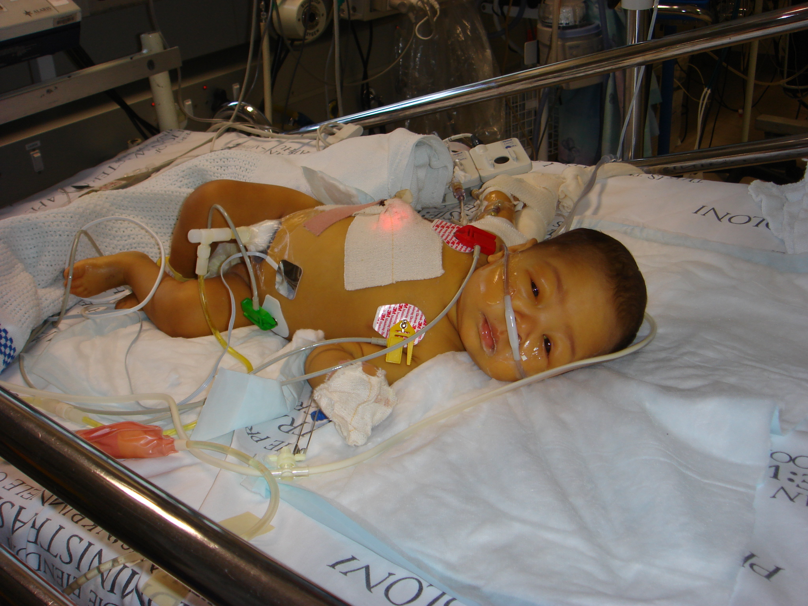
CASE

Slide 12
CLINICAL PRESENTATION
History may give an idea to the back ground of renal failure
Oliguria (<0.5-1ml/kg/hr)
Anuria (<1ml/kg/day)
Volume overload
Hypertension
Cardiac failure
Encephalopathy

Slide 13
Investigations
Urine output, microscopy, SG
Fractional excretion of sodium
Urea, creatinine
Potassium
Ultrasound
CXR
FBC
OTHER

Slide 14
Investigations
Urine : SG, blood, protein, microscopy red cell casts
Urine chemistry: sodium <20mmol/l (prerenal) >30 (renal)
Fractional excretion of sodium FE_{Na} < 1% (prerenal) > 2%(renal)

Slide 15
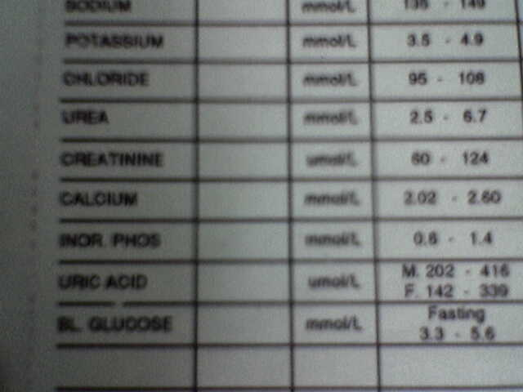
Common problems with creatinine
Assuming a child 9 months old with creatinine of 80umol/l
Is that normal?
GFR=60X40/80
30ML/MIN/1.73M2

Slide 16
Useful formulae
Schwartz GFR(ml/mil/1.73m² )
Ht X 40 = 75 X 40 = 15
Creatinine 200
Systolic BP
(Age in yrs X 3) + 100 = 95th Centile

Slide 17
MANAGEMENT
TREATMENT OF UNDERLYING DISEASE
FLUIDS
ELECTROLYTES
ACIDOSIS
HYPERTENSION
SEPSIS
RENAL REPLACEMENT
NUTRITION

Slide 18
Fluid balance
Important to differentiate prerenal from renal cause
Important to assess hydration as hypovolemic states need to be given fluids
If hypervolemic may need fluid restriction
If in doubt give fluid challenge with saline 10 ml/kg x 3 before lasix at high dose 4 mg/kg

Slide 19
FLUIDS
CHECK INPUT/OUTPUT
Daily weights
Urine Na
Check hydration
Fluid restriction 300-400ml/m²

Slide 20
electrolytes
Potassium
Sodium
calcium

Slide 21
Medical management Hyperkalaemia Cochrane Database Syst Rev 2007 Jan 24;(1):CD005257
Peaked T waves, loss of P waves, wide QRS complex, bradycardia, VT
Place on cardiac monitor
Ca gluconate 10% 0.5 ml/kg IV over 10 min
Salbutamol nebs 2.5-5mg
Correct acidosis sodium bicarbonate 1-2mmol/kg IV over 30 min
Ca resonium 1g/kg
Glucose 0.5-1g/kg and insulin 0.1-0.2units/kg or 10% dextrose at 5ml/kg/h with insulin 0.1unit/kg/hr

Slide 22
Dialysis
Indications:
Hyperkalemia
Overload
Acidosis not responding
Ureamia clinical urea levels >30mmol/l
Tumor lysis
Require space

Slide 23
Dialysis
ACUTE PD
MANUAL
AUTOMATED
HEMODIALYSIS

Slide 24
PD V/S HD

Slide 25
Peritoneal Dialysis
Ease of obtaining access
Lack of sophisticated equipment
Personnel with prior technical expertise not required
Severe life-threatening hyperK /acidosis
ease & rapidity with which this can be initiated
Haemodynamic instability where hypotension would prevent satisfactory haemodialysis

Slide 26
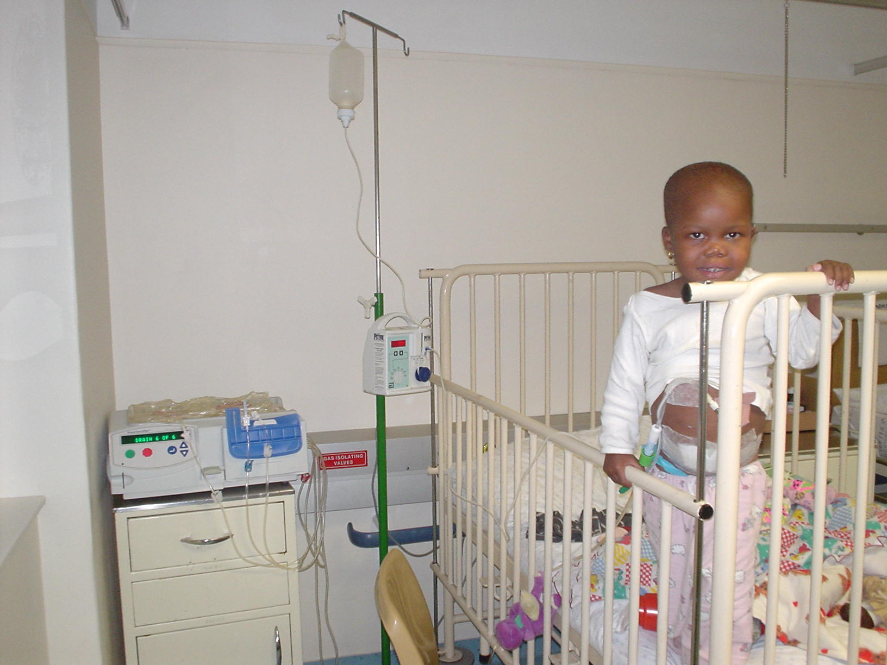

Slide 27
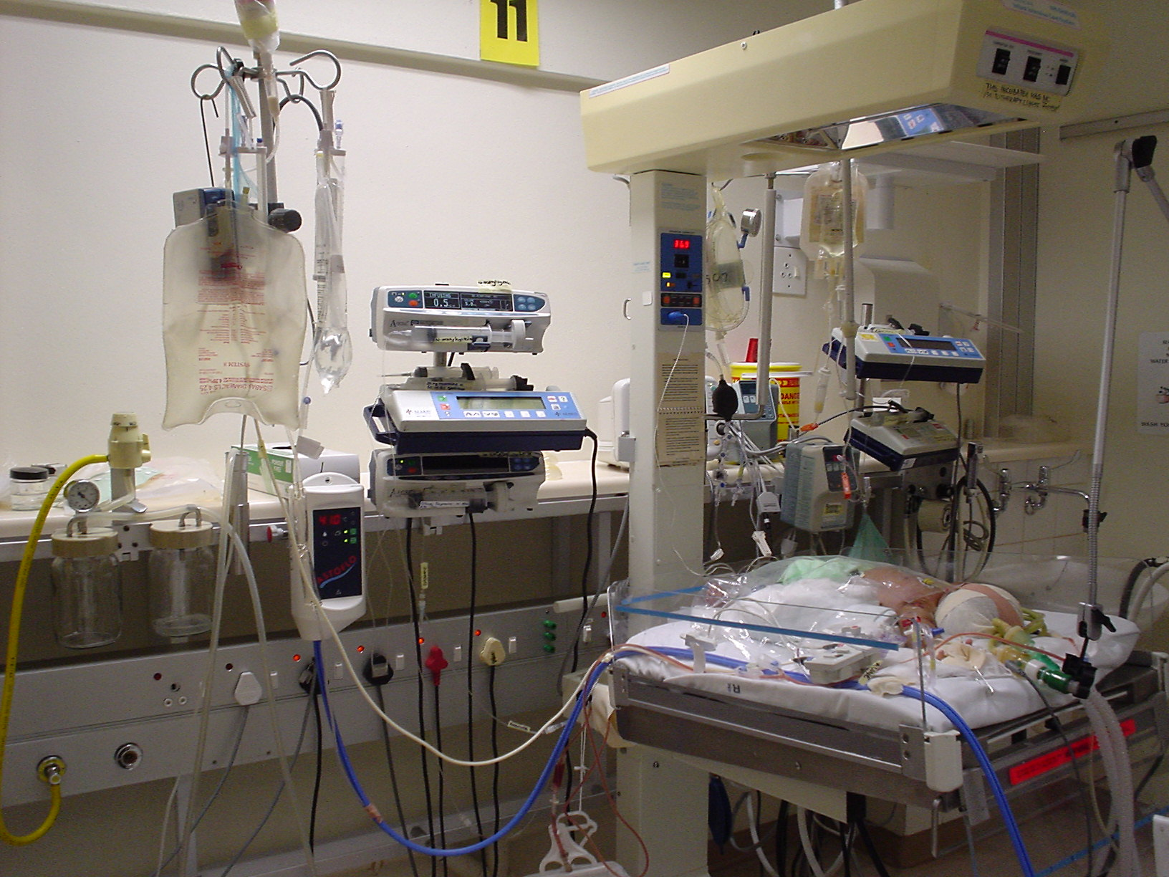

Slide 28
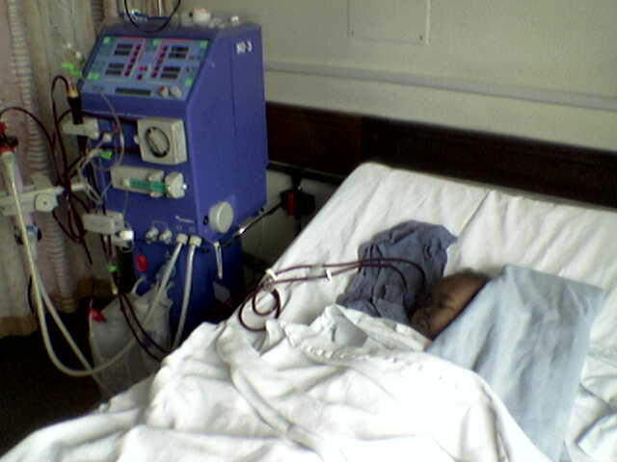
Haemodialysis

Slide 29
Case
Child transferred to the ward on peritoneal dialysis
Went to theatre for surgical Tenckhoff insertion
30 days of dialysis passed some urine
Now passing urine 2ml/kg/hr and off dialysis
Current creatinine – 71umol/l…………

Slide 30
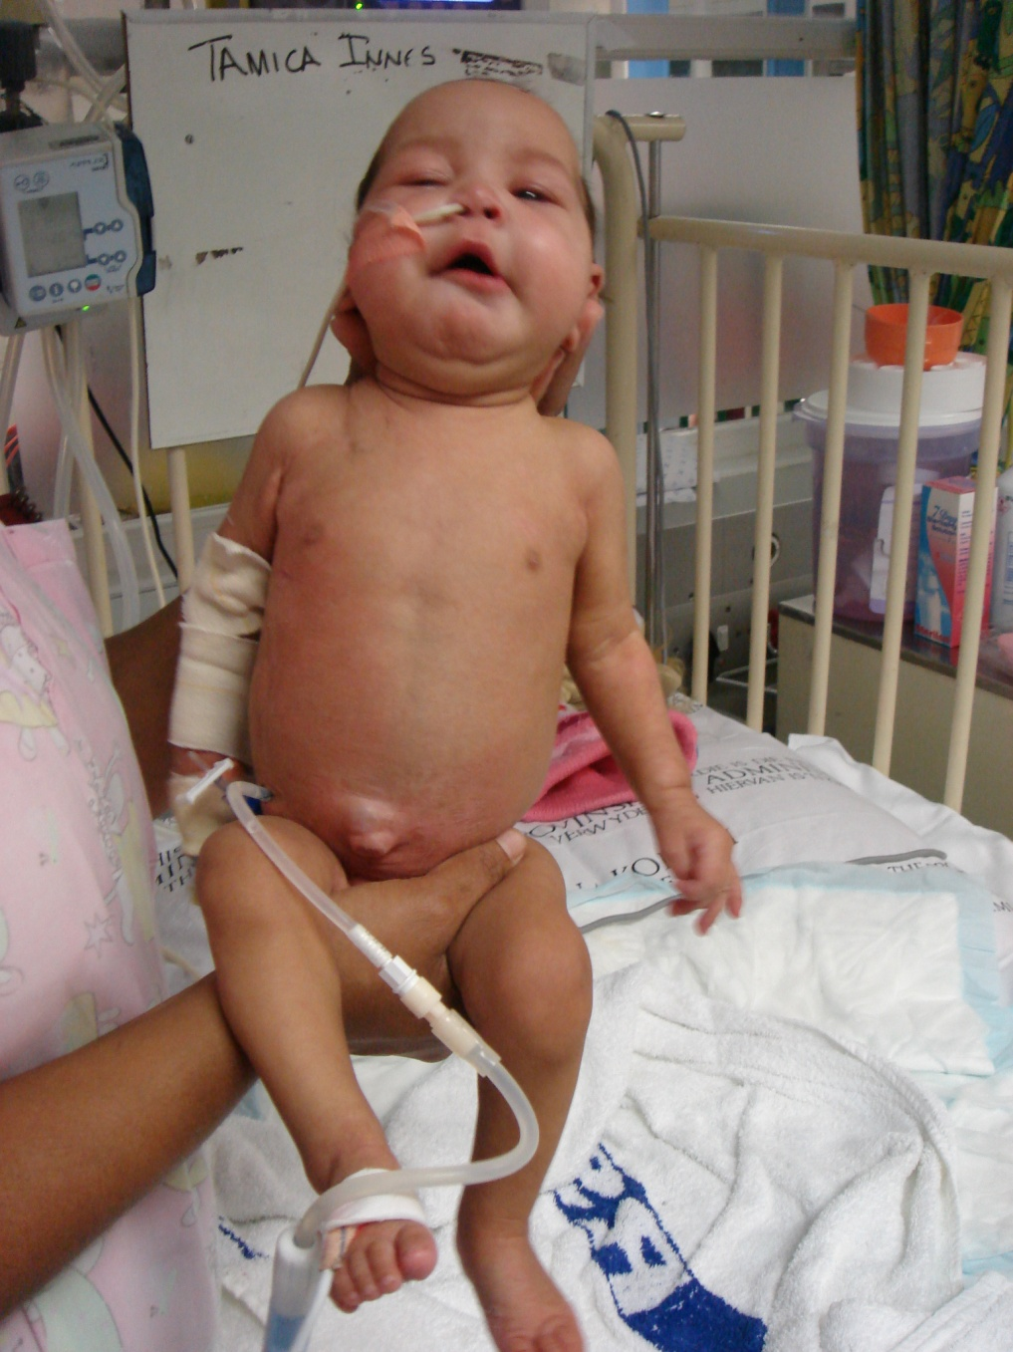

Slide 31
OUTCOMES

Slide 32
TAKE HOME MESSAGE
Early diagnosis of renal failure important
Supportive management crucial
Early replacement therapy may be life saving
Acute peritoneal dialysis is ideal modality for children
What looks like normal renal function might not be normal after all
If in doubt call a friend ( seek help)

Slide 33
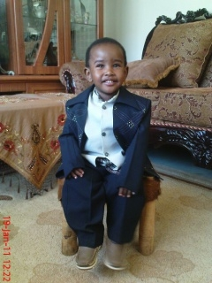
Thank you

